Slide 1
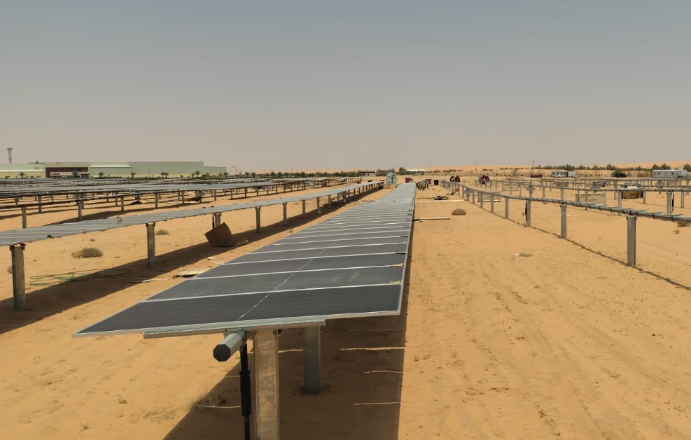
PROJECT 03
Golden Chicken Solar PV
Completed project
PROJECT DESCRIPTION
A Solar PV project designed to harness clean energy and reduce conventional power consumption at the Golden Chicken facility
Add project image here
KEY FACTS
Capacity
5.0 MWp
Location
Shaqra,KSA
Scope
Turnkey EPC
Status
Completed

Slide 2
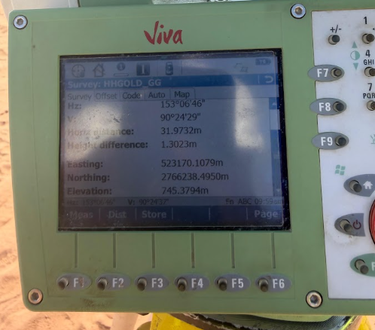
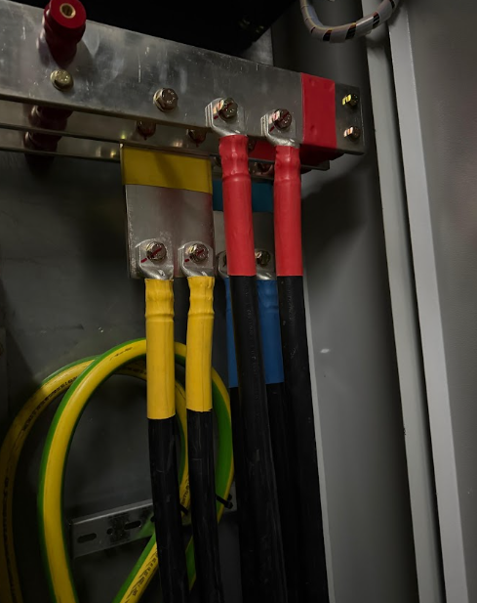
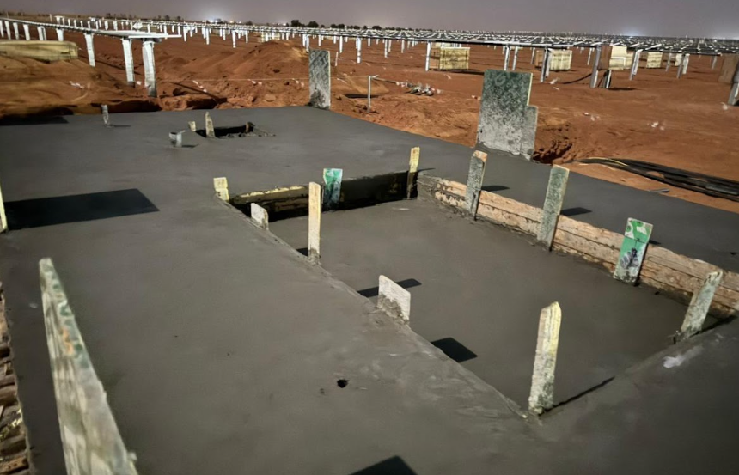
PROJECT 03 · SITE GALLERY
Golden Chicken Solar PV
Images & delivery notes
Add image
Add image
Add image
DELIVERY NOTES
The project was successfully completed and handed over, meeting the required project, safety, and quality standards.

